Slide 1



Car Insurance Claims Database
Yichun Chen
December 2021

Slide 2
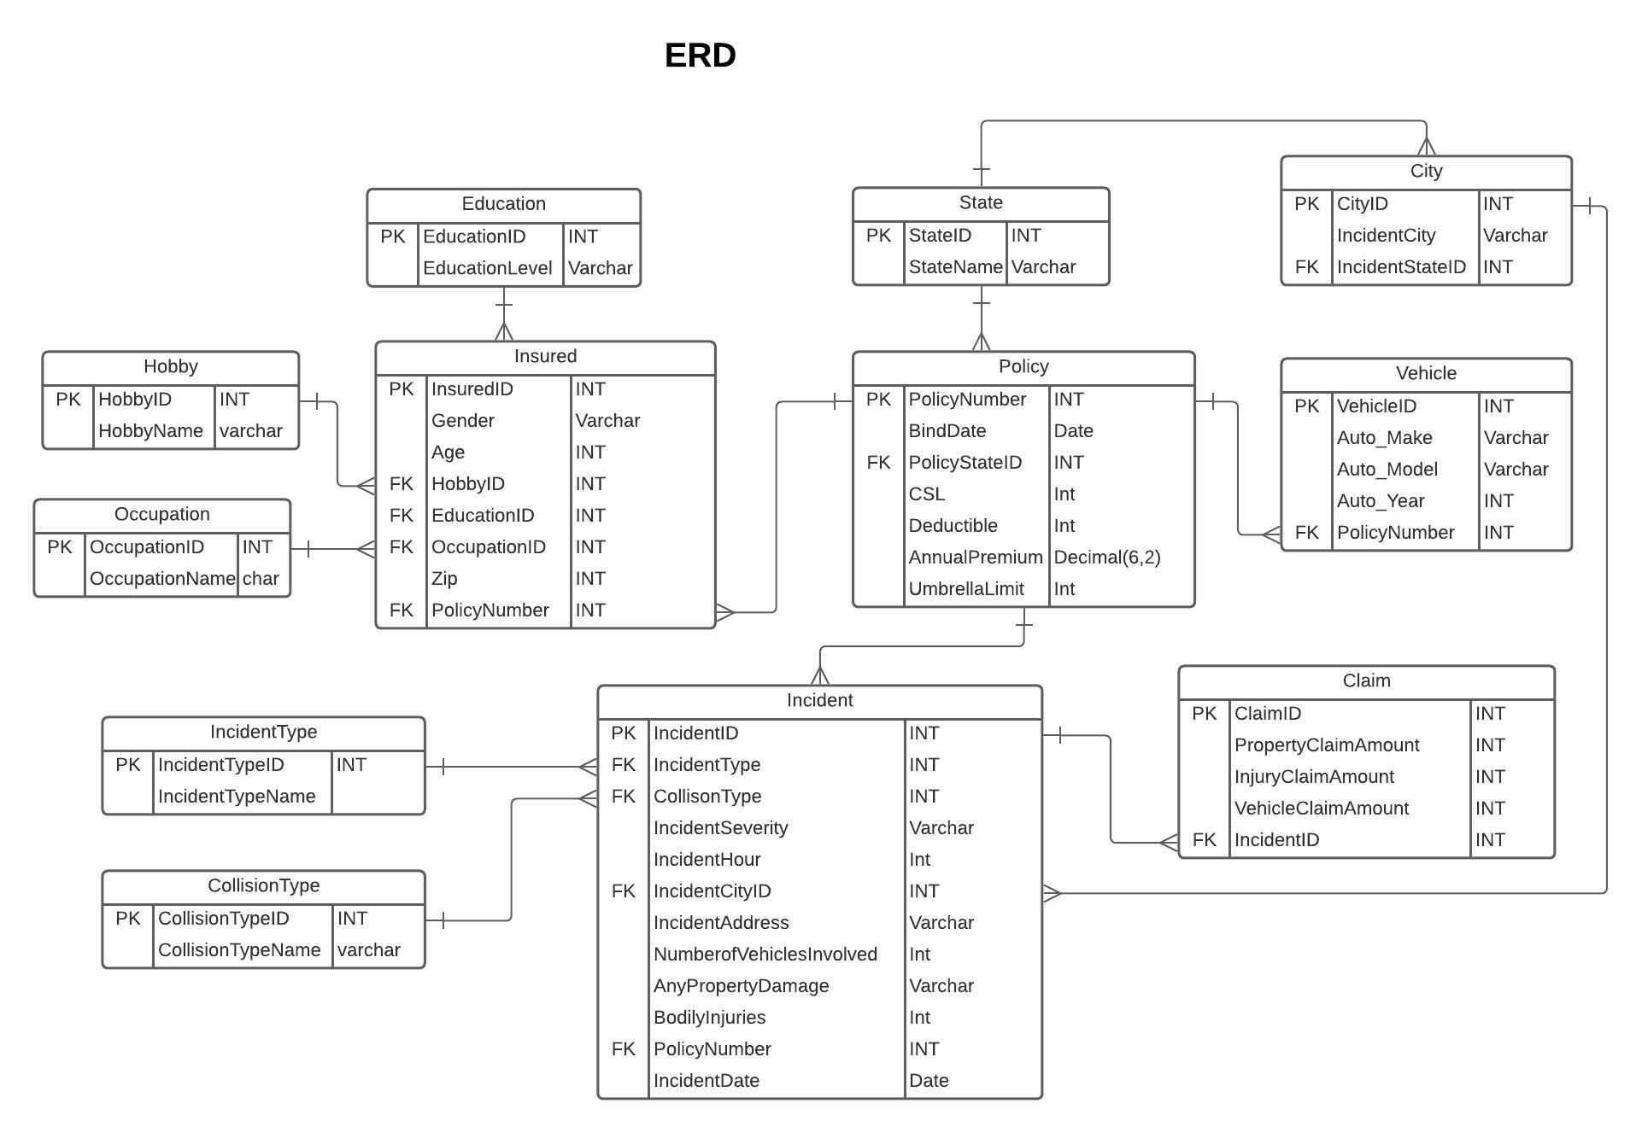

Slide 3
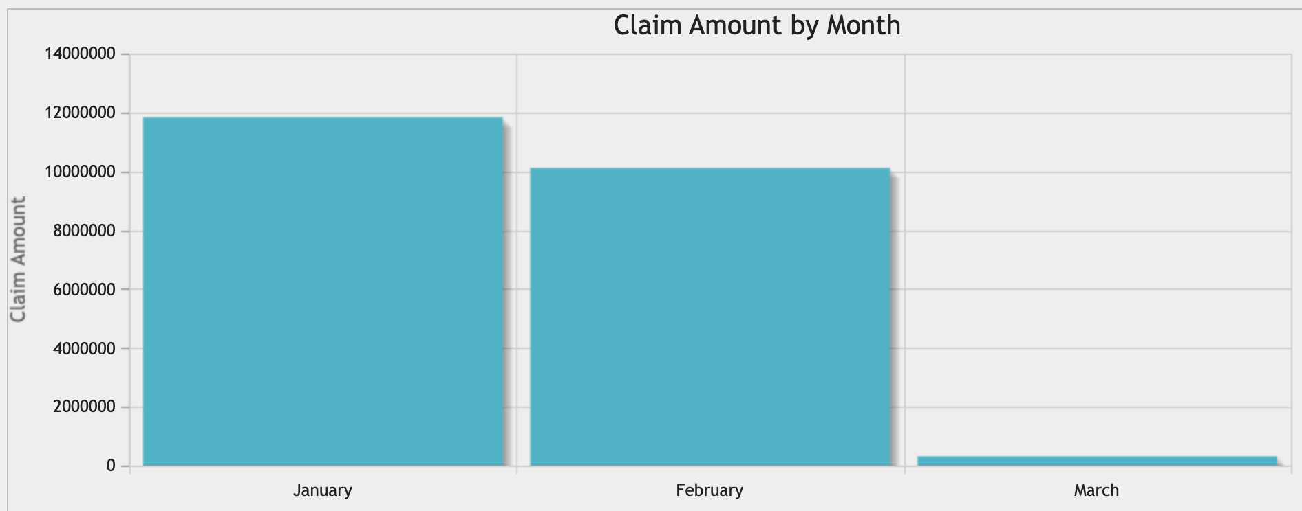
1. Display total claim amount by year and by month: SELECT Year(`IncidentDate`), Date_Format(`IncidentDate`,'%M') AS Month, SUM(PropertyClaimAmount)+ SUM(`InjuryClaimAmount`)+ SUM(`InjuryClaimAmount`) as TotalClaimAmount FROM `FinalProject_claims_view` GROUP BY 1, 2 ORDER BY 3 DESC
Year(`IncidentDate`) | Month | TotalClaimAmount
2015 | January | 11835600
2015 | February | 10117650
2015 | March | 313160

Slide 4
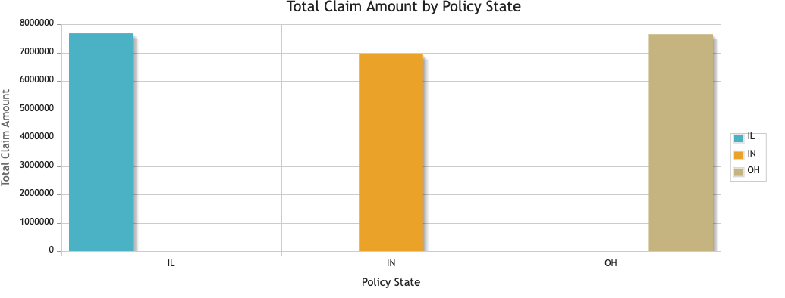
2. Display total claim amount by PolicyState : SELECT PolicyState, SUM(PropertyClaimAmount)+ SUM(InjuryClaimAmount)+ SUM(InjuryClaimAmount) as TotalClaimAmount FROM `FinalProject_claims_view` GROUP BY 1
PolicyState | TotalClaimAmount
IL | 7677980
IN | 6940170
OH | 7648260

Slide 5
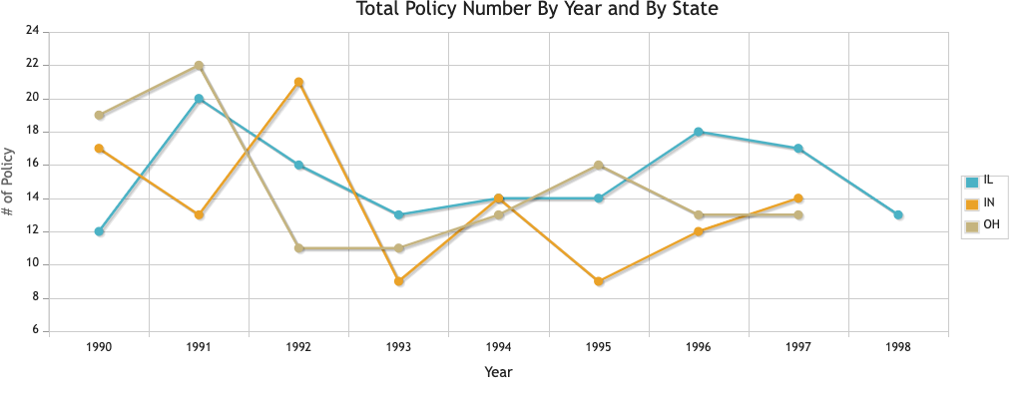
3. Display number of policies by year and by state SELECT year(BindDate), s.StateName as PolicyState, COUNT(*) FROM cl_policy p, cl_state s WHERE p.PolicyStateID = s.StateID GROUP BY 1, 2
year(BindDate) | PolicyState | COUNT(*)
1990 | IL | 12
1990 | IN | 17
1990 | OH | 19
1991 | IL | 20
1991 | IN | 13
1991 | OH | 22
1992 | IL | 16
1992 | IN | 21
1992 | OH | 11
1993 | IL | 13
1993 | IN | 9
1993 | OH | 11
1994 | IL | 14

Slide 6
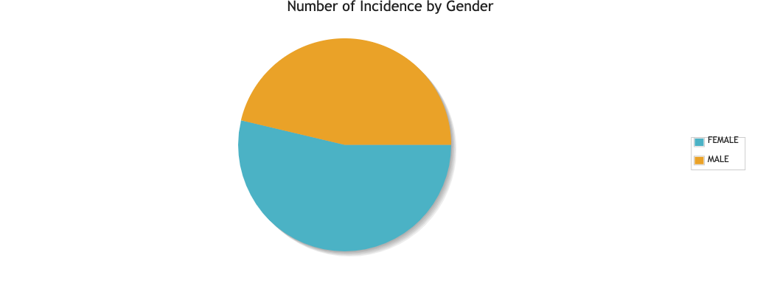
4. Display number of incidents by gender SELECT Gender, Count(*) FROM FinalProject_claims_view GROUP BY 1
Gender | Count(*)
FEMALE | 537
MALE | 463

Slide 7
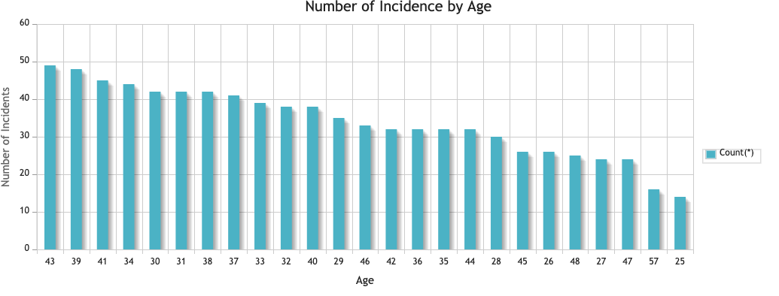
5. Display number of incidents by driver’s age SELECT Age, Count(*) FROM FinalProject_claims_view GROUP BY 1 ORDER BY 2 DESC
Age | Count(*)
43 | 49
39 | 48
41 | 45
34 | 44
31 | 42
38 | 42
30 | 42
37 | 41
33 | 39
32 | 38
40 | 38
29 | 35
46 | 33
36 | 32
35 | 32
44 | 32
42 | 32
28 | 30
45 | 26

Slide 8
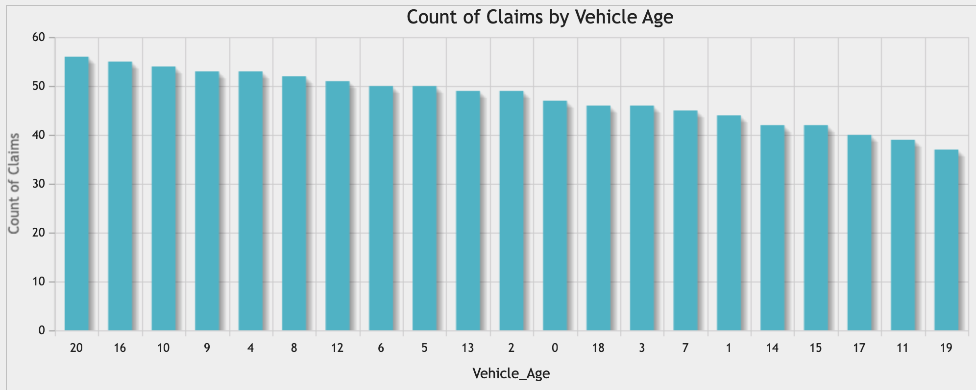
6. Display number of claims by vehicle age SELECT Auto_Year, Year(IncidentDate)- Auto_Year as Vehicle_Age, COUNT(*) FROM FinalProject_claims_view GROUP BY 1, 2 ORDER BY 3 DESC
Auto_Year | Vehicle_Age | COUNT(*)
1995 | 20 | 56
1999 | 16 | 55
2005 | 10 | 54
2011 | 4 | 53
2006 | 9 | 53
2007 | 8 | 52
2003 | 12 | 51
2009 | 6 | 50
2010 | 5 | 50
2002 | 13 | 49
2013 | 2 | 49
2015 | 0 | 47
1997 | 18 | 46
2012 | 3 | 46
2008 | 7 | 45

Slide 9
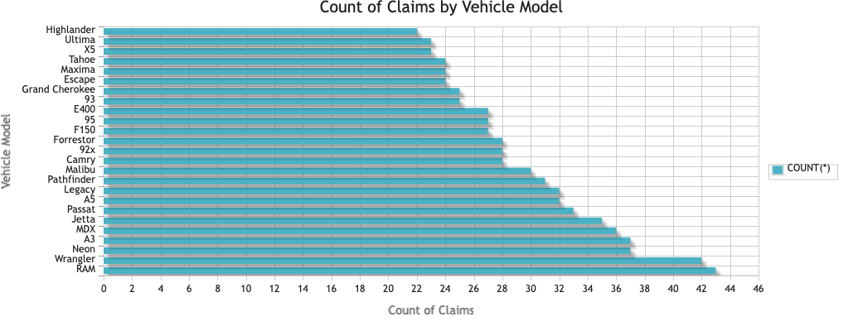
7. Display number of incidents by Auto_Model (Which vehicle Model tend to have more claims?) SELECT Auto_Model, COUNT(*) FROM FinalProject_claims_view GROUP BY 1 ORDER BY 2 DESC
Auto_Model | COUNT(*)
RAM | 43
Wrangler | 42
Neon | 37
A3 | 37
MDX | 36
Jetta | 35
Passat | 33
A5 | 32
Legacy | 32
Pathfinder | 31
Malibu | 30
Forrestor | 28

Slide 10
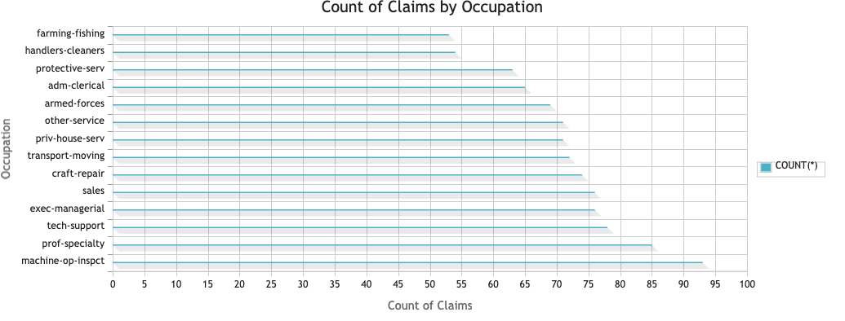
8. Display number of claims by occupation SELECT OccupationName, COUNT(*) FROM FinalProject_claims_view GROUP BY 1 ORDER BY 2 DESC
OccupationName | COUNT(*)
machine-op-inspct | 93
prof-specialty | 85
tech-support | 78
exec-managerial | 76
sales | 76
craft-repair | 74
transport-moving | 72
priv-house-serv | 71
other-service | 71
armed-forces | 69
adm-clerical | 65
protective-serv | 63
handlers-cleaners | 54
farming-fishing | 53

Slide 11
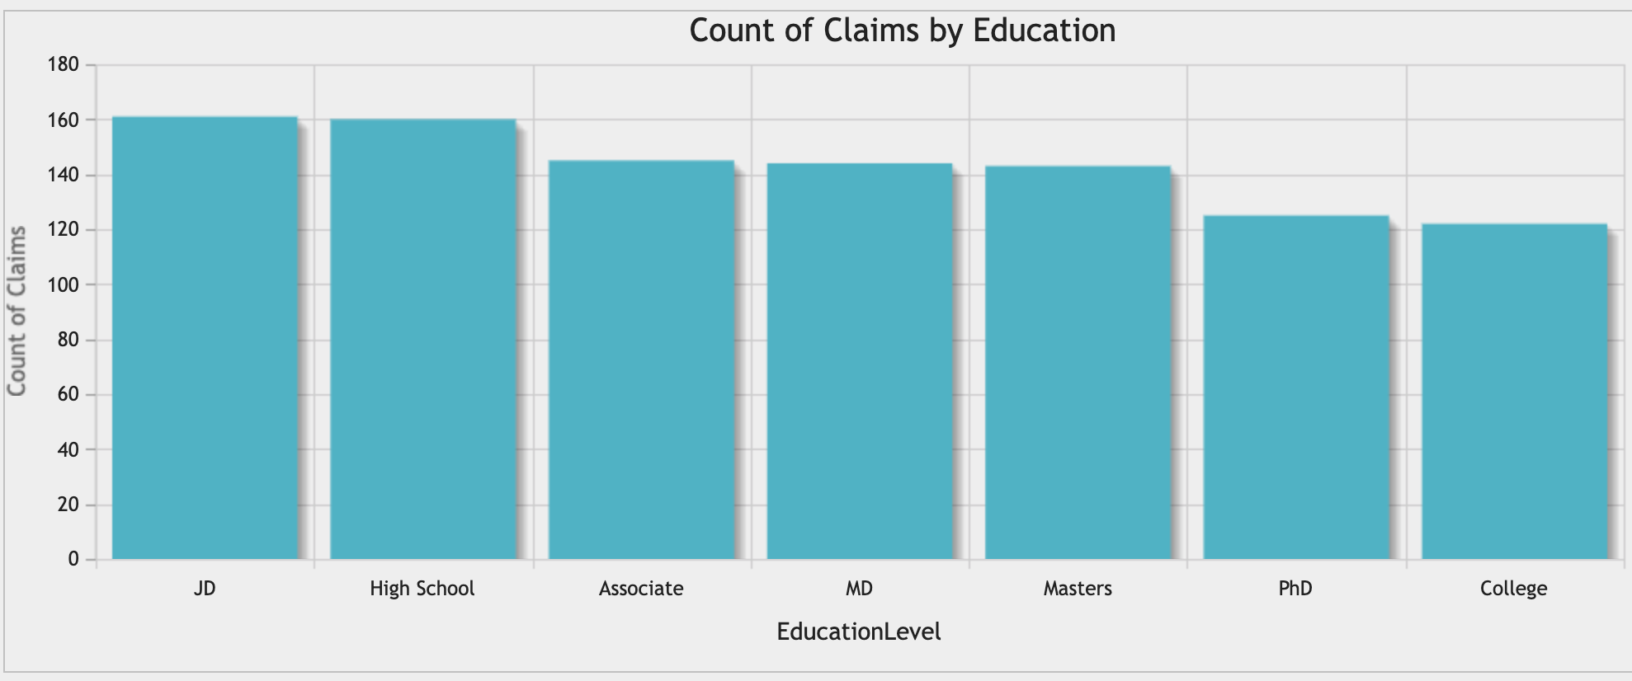
9. Display number of claims by education (Does education affect claims?) SELECT EducationLevel, COUNT(*) FROM FinalProject_claims_view GROUP BY 1 ORDER BY 2 DESC
EducationLevel | COUNT(*)
JD | 161
High School | 160
Associate | 145
MD | 144
Masters | 143
PhD | 125
College | 122

Slide 12
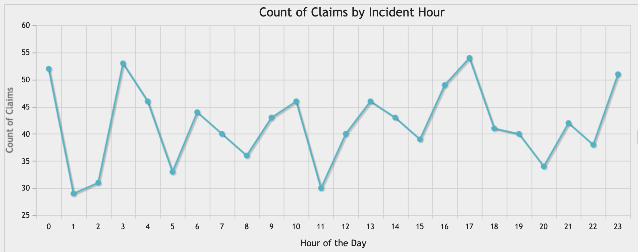
10. Display number of claims by incident hour (In which hour of the day does most incidents occur?) SELECT IncidentHour, COUNT(*) FROM FinalProject_claims_view GROUP BY 1 ORDER BY 1
IncidentHour | COUNT(*)
0 | 52
1 | 29
2 | 31
3 | 53
4 | 46
5 | 33
6 | 44
7 | 40
8 | 36
9 | 43
10 | 46
11 | 30
12 | 40
13 | 46
14 | 43
15 | 39
16 | 49
17 | 54
18 | 41
19 | 40
20 | 34
21 | 42
22 | 38
23 | 51

Slide 13
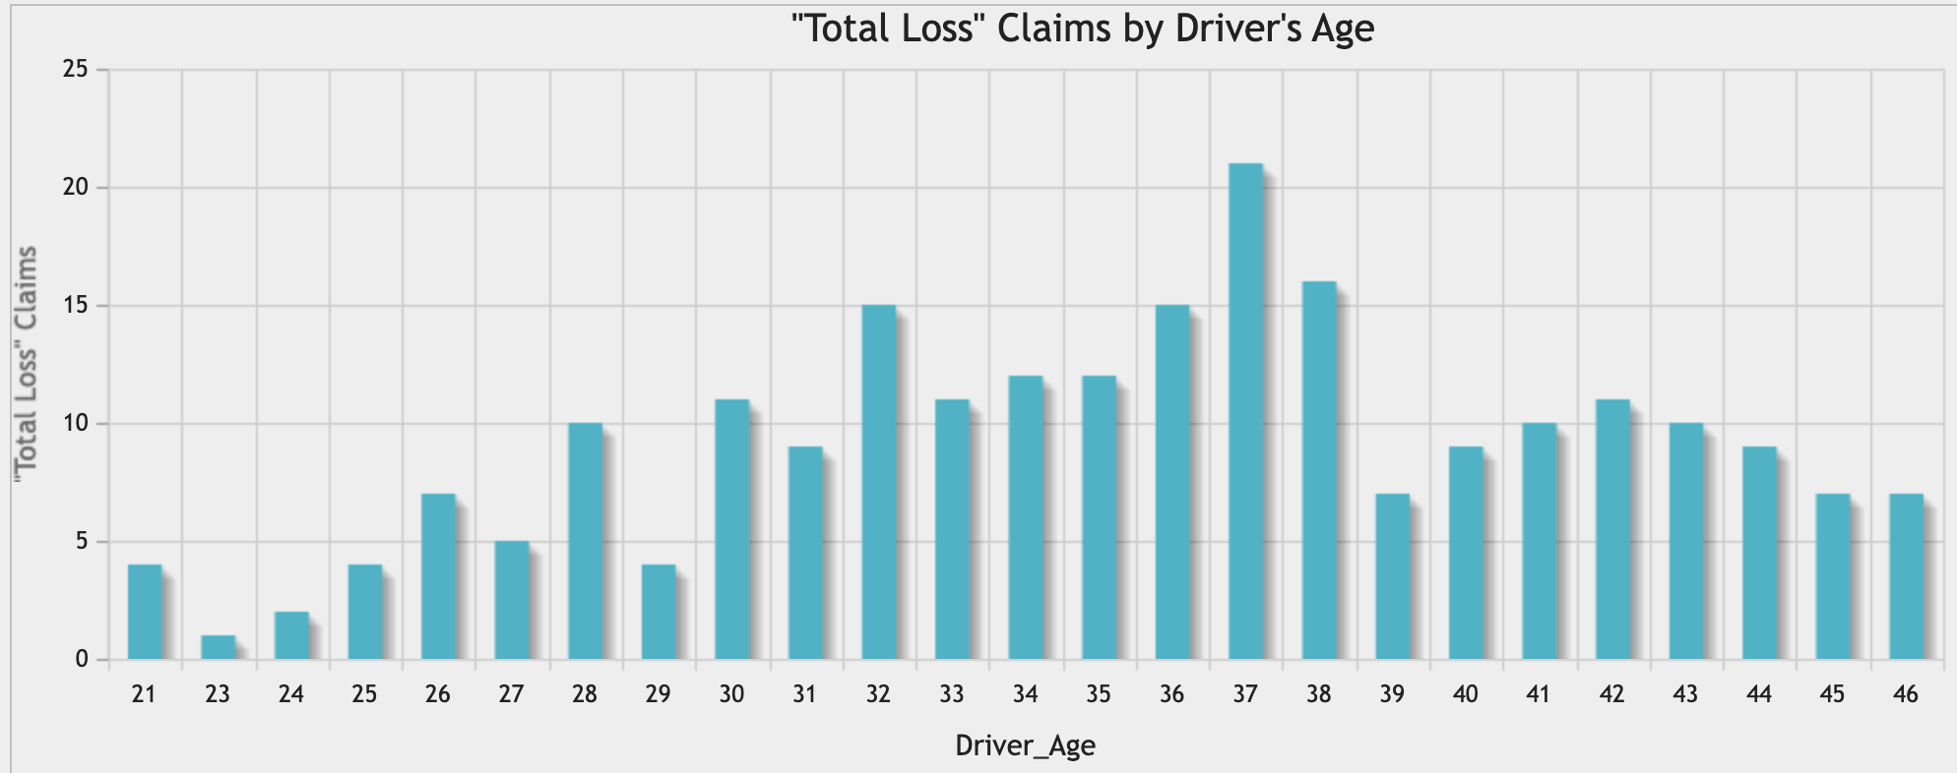
11. Display number of ‘total loss’ claims by driver age SELECT IncidentSeverity, Age as Driver_Age, COUNT(*) FROM FinalProject_claims_view WHERE IncidentSeverity = 'Total Loss' GROUP BY 1,2 ORDER BY 2
IncidentSeverity | Driver_Age | COUNT(*)
Total Loss | 21 | 4
Total Loss | 23 | 1
Total Loss | 24 | 2
Total Loss | 25 | 4
Total Loss | 26 | 7
Total Loss | 27 | 5
Total Loss | 28 | 10
Total Loss | 29 | 4
Total Loss | 30 | 11
Total Loss | 31 | 9
Total Loss | 32 | 15
Total Loss | 33 | 11
Total Loss | 34 | 12
Total Loss | 35 | 12
Total Loss | 36 | 15
Total Loss | 37 | 21
Total Loss | 38 | 16
Total Loss | 39 | 7
Total Loss | 40 | 9
Total Loss | 41 | 10
Total Loss | 42 | 11
Total Loss | 43 | 10
Total Loss | 44 | 9
Total Loss | 45 | 7
Total Loss | 46 | 7

Slide 14
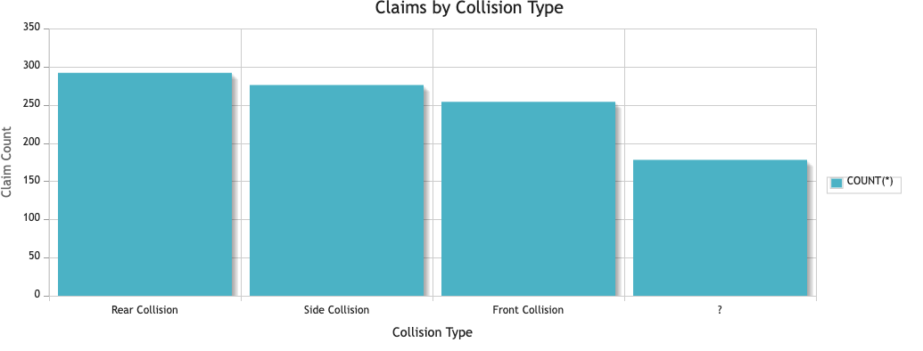
12. Display number of claims by collision type SELECT CollisionTypeName, COUNT(*) FROM FinalProject_claims_view GROUP BY 1 ORDER BY 2 DESC
CollisionTypeName | COUNT(*)
Rear Collision | 292
Side Collision | 276
Front Collision | 254
? | 178

Slide 15
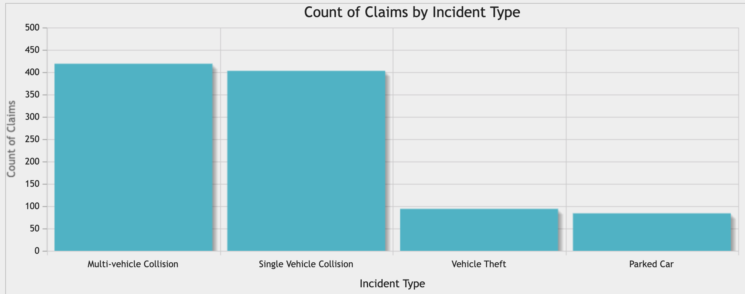
13. Display number of claims by incident type? SELECT IncidentTypeName, COUNT(*) FROM FinalProject_claims_view GROUP BY 1 ORDER BY 2 DESC
IncidentTypeName | COUNT(*)
Multi-vehicle Collision | 419
Single Vehicle Collision | 403
Vehicle Theft | 94
Parked Car | 84

Slide 16
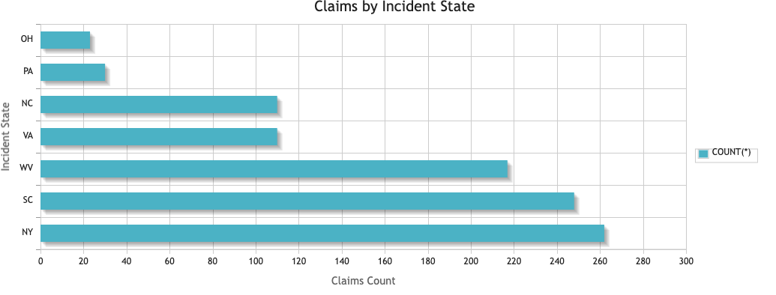
14. Display number of claims by Incident State SELECT IncidentState, COUNT(*) FROM FinalProject_claims_view GROUP BY 1 ORDER BY 2 DESC
IncidentState | COUNT(*)
NY | 262
SC | 248
WV | 217
NC | 110
VA | 110
PA | 30
OH | 23

Slide 17
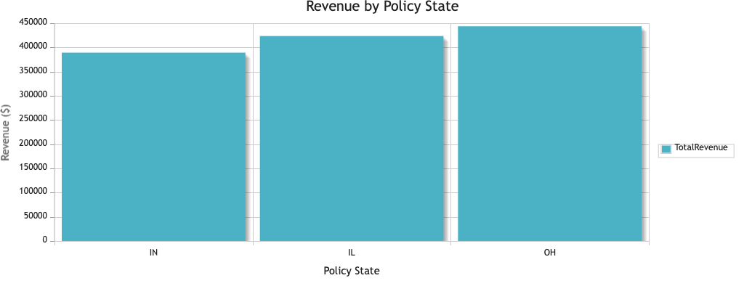
14. Display Total Revenue by policy state SELECT PolicyState, SUM(AnnualPremium) TotalRevenue FROM `FinalProject_claims_view` GROUP BY 1 ORDER BY 2
PolicyState | TotalRevenue
IN | 389172.29
IL | 423559.80
OH | 443674.06

Slide 18


Thank You!
Any Questions?

